Slide 1
TasteRank
Food
Dining
Restaurant
DADS5001 Tools
Group Members
Sarun Thaeppunkulngam 6720422001
Chotepipat Chatkoonbunmai 6720422023
Kingkamon Jaroenkobun 6720422027

Slide 2

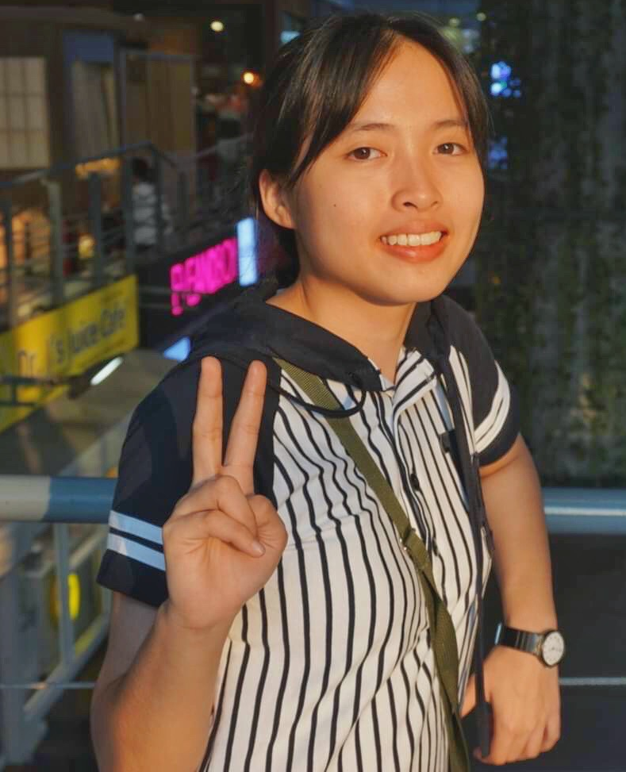

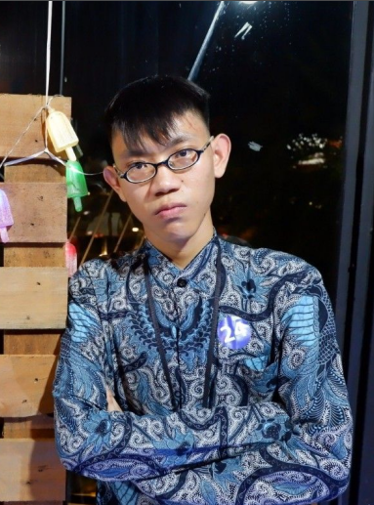
MEET THE TEAM
Sarun
Chotepipat
Kingkamon
2

Slide 3
CONTENTS
01. Issues and motivation
02. Objective
03. Solution (Methodology)
3.1 Traditional
3.2 AI add-on
04. Visualization (Streamlit)
05. Appendix (Submit via Github and Others)

Slide 4
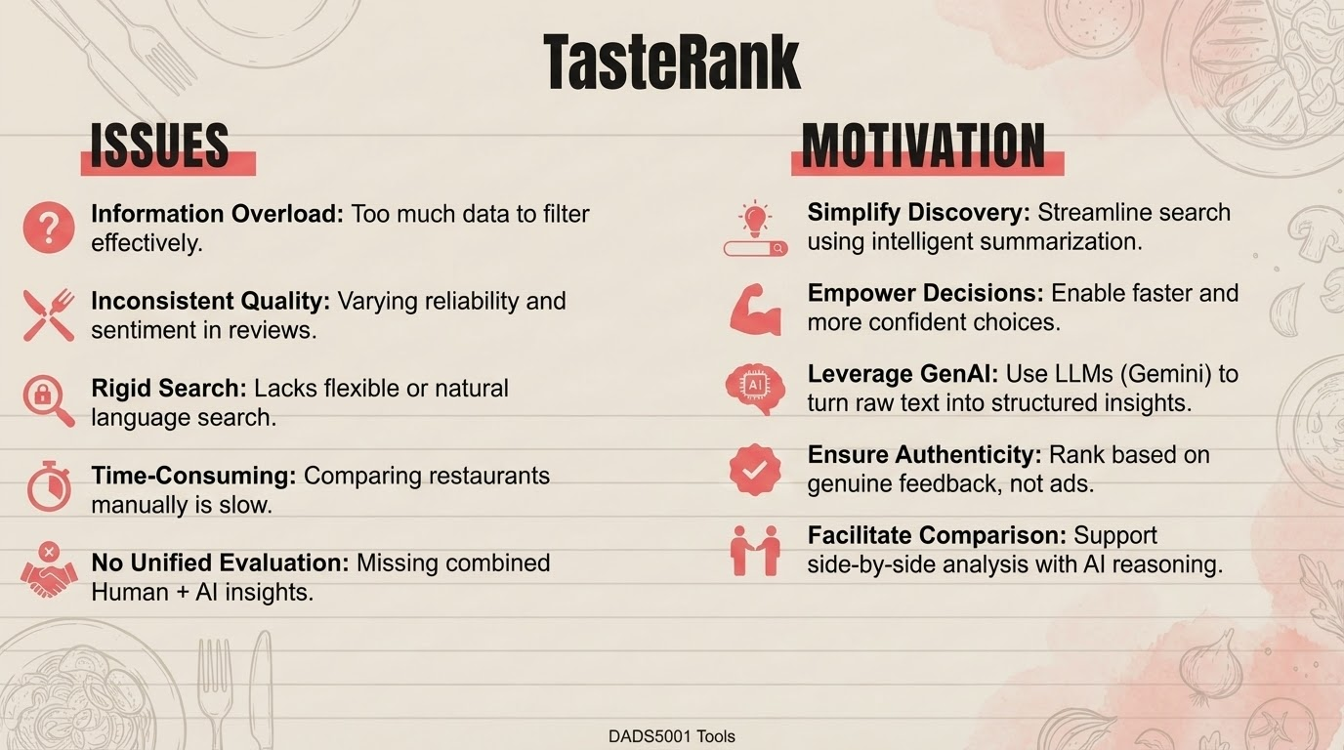
4

Slide 5
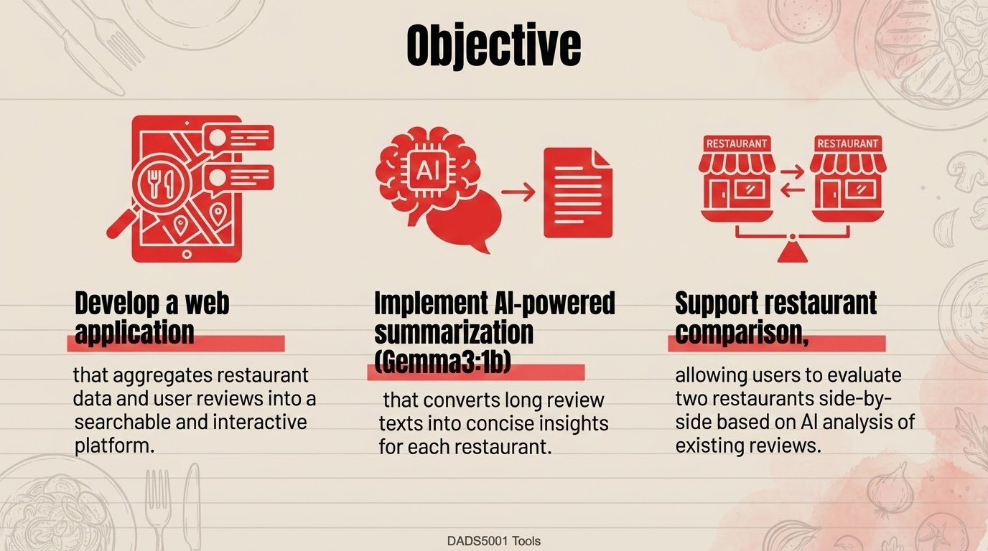
5

Slide 6
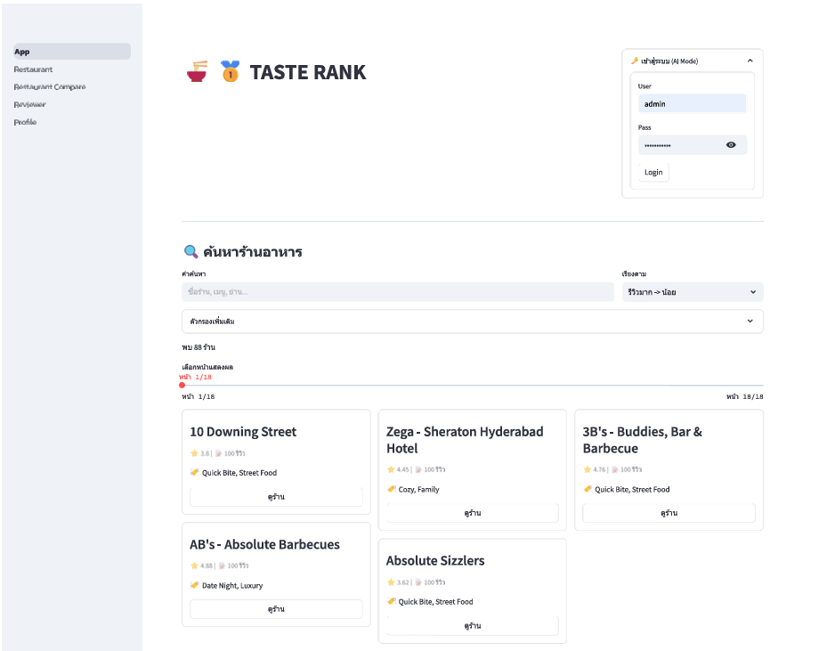
DEMO
6

Slide 7
Github
https://github.com/ChotepipatC/DADS5001_FinalProject_TASTE-RANK
Github
7

Slide 8
THANK YOU!

